Slide 1
A Bulgária (cont.)
Trabalho de Mª Inês Silva

Slide 2
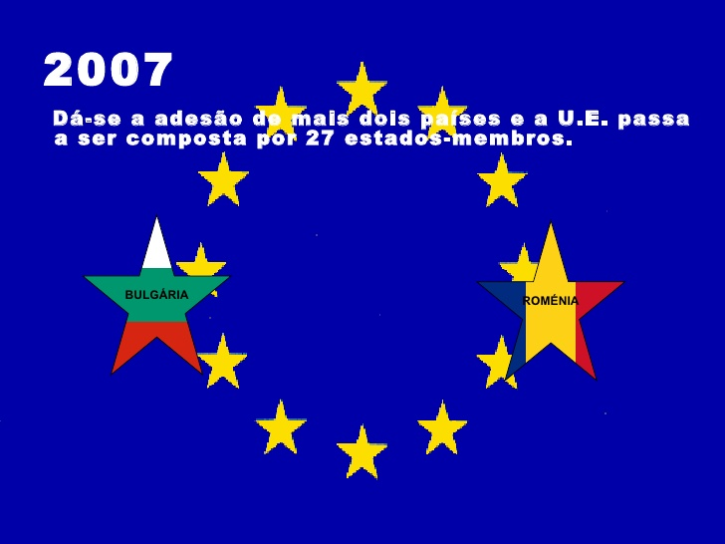
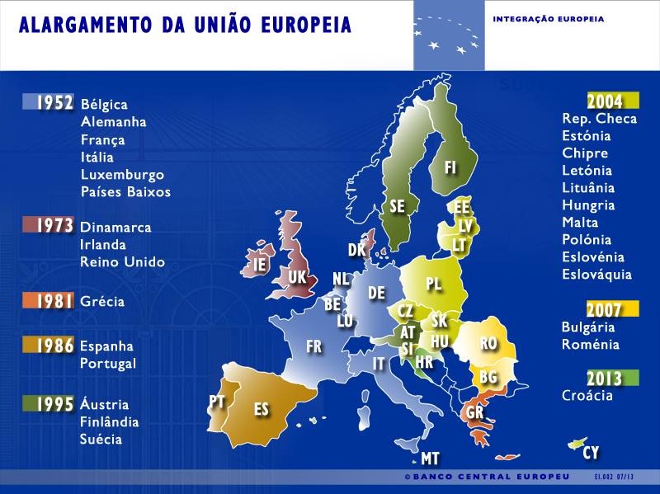
Adesão à UE
A Bulgária aderiu à UE (União Europeia) a 1 de Janeiro de 2007.

Slide 3
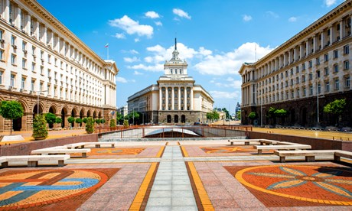
Um pouco sobre...
A capital

Slide 4
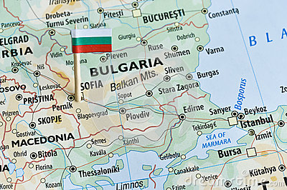
A capital
A capital da Bulgária como já foi refarido é Sófia e tem cerca de 1 milhão de habitantes.
As cidades de Sófia são: Sófia, Pleven, Ruse, Varna, Burgas e Plovdiv.

Slide 5
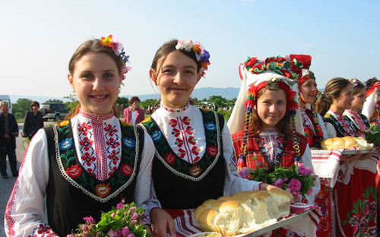
Um pouco sobre...
Cultura

Slide 6
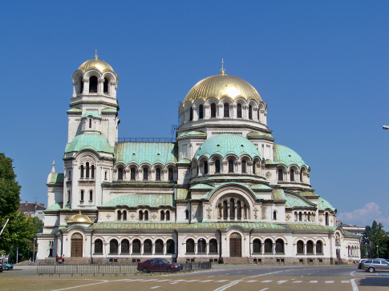
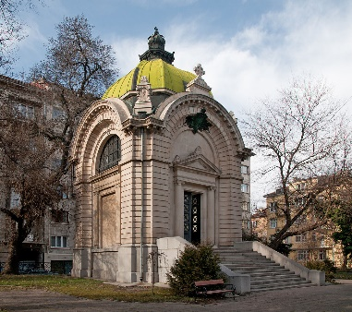
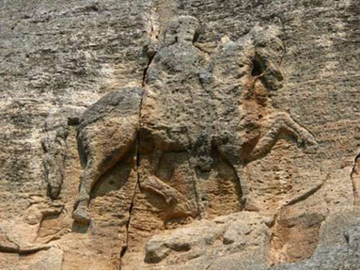
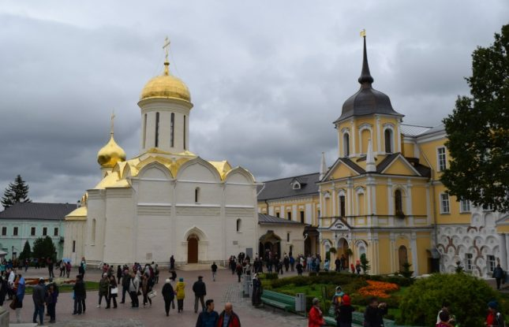
Principais monumentos
A Catedral-monumento St. Alejandro Nevski
O Memorial Tomb of Alexander I de Battenberg
O cavaleiro de Madara
O Mosteiro Patriarcal da Santíssima Trindade

Slide 7
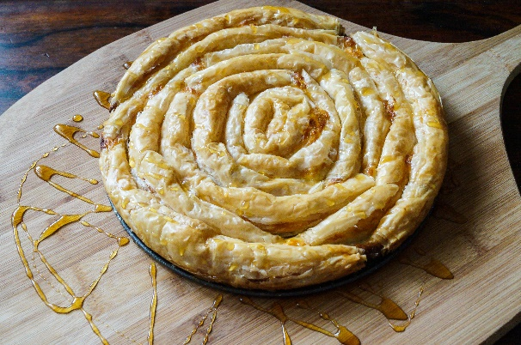
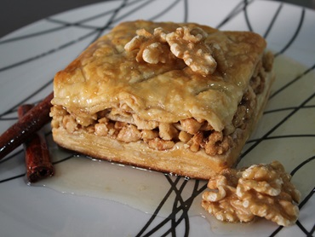
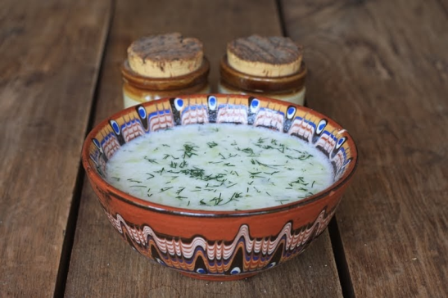
Principais pratos
Baklava (doce Com Nozes)
Banitsa
Tarator

Slide 8
Webgrafia
https://pt.wikipedia.org/wiki/Bulg%C3%A1ria
https://www.infopedia.pt/$bulgaria
https://es.wikipedia.org/wiki/Categor%C3%ADa:Monumentos_de_Bulgaria
https://www.google.pt/url?sa=i&rct=j&q=&esrc=s&source=images&cd=&cad=rja&uact=8&ved=0ahUKEwjDvc_qoMrVAhVJWxoKHcsGCZMQjRwIBg&url=https%3A%2F%2Fbusca.saraiva.com.br%2Fq%2Fglobo%2Bterrestre&psig=AFQjCNEvMRIDVbXrNhJUKMX7YYeiw1LQQw&ust=1502371433152463
https://www.google.pt/url?sa=i&rct=j&q=&esrc=s&source=images&cd=&cad=rja&uact=8&ved=0ahUKEwju1uqWocrVAhXILhoKHdoeCZIQjRwIBg&url=https%3A%2F%2Fwww.infoplease.com%2Fatlas%2Fbulgaria&psig=AFQjCNGoKgVL1sSUh3NnMMJ2RdjPnB4Dug&ust=1502371783020016
https://www.google.pt/url?sa=i&rct=j&q=&esrc=s&source=images&cd=&cad=rja&uact=8&ved=0ahUKEwj-t-etocrVAhUD22MKHc7cAeMQjRwIBg&url=http%3A%2F%2Fwww.operationworld.org%2FBULG&psig=AFQjCNGoKgVL1sSUh3NnMMJ2RdjPnB4Dug&ust=1502371783020016
https://www.google.pt/url?sa=i&rct=j&q=&esrc=s&source=images&cd=&cad=rja&uact=8&ved=0ahUKEwinwa_EocrVAhWGAxoKHXRICpMQjRwIBg&url=http%3A%2F%2Fwww.guiaviagem.org%2Fbulgaria-atracoes-turisticas%2F&psig=AFQjCNHF262KtfLmAuFBQ52k-n0qKlrnmg&ust=1502371875079048
https://www.google.pt/url?sa=i&rct=j&q=&esrc=s&source=images&cd=&cad=rja&uact=8&ved=0ahUKEwjCj4aRpMrVAhXBtBoKHUj1CZcQjRwIBg&url=http%3A%2F%2Fpt.depositphotos.com%2F97123984%2Fstock-photo-summer-sandy-beach-in-bulgaria.html&psig=AFQjCNG9azOgk00Q7x11XiMzbsKXP1agzg&ust=1502372561673403

Slide 9
Webgrafia
https://www.google.pt/url?sa=i&rct=j&q=&esrc=s&source=images&cd=&cad=rja&uact=8&ved=0ahUKEwiP9by-pMrVAhVB1RoKHck3DpEQjRwIBg&url=http%3A%2F%2Fterceiro-setor.info%2Fcomo-criar-uma-ong.html&psig=AFQjCNFT2x3u9JOGdCin9tDywE-pGJ4rKw&ust=1502372665755157
https://www.google.pt/url?sa=i&rct=j&q=&esrc=s&source=images&cd=&cad=rja&uact=8&ved=0ahUKEwj8ypTlpcrVAhVY0WMKHefVBPkQjRwIBg&url=http%3A%2F%2Fcultura.culturamix.com%2Fcuriosidades%2Fmiscigenacao-da-lingua-portuguesa-no-brasil&psig=AFQjCNGvANZaAhoYv-D2aqjHXhgjIrMXxg&ust=1502373017419407
https://www.google.pt/url?sa=i&rct=j&q=&esrc=s&source=images&cd=&cad=rja&uact=8&ved=0ahUKEwjt7eqNpsrVAhWIOBoKHdZUA5gQjRwIBg&url=http%3A%2F%2Fjornalcultura.sapo.ao%2Fgrafitos-na-alma%2Fsera-a-religiao-um-instrumento-de-dominacao%2Ffotos&psig=AFQjCNHr984-s2-etFV1pHCVjX2zoC0wsQ&ust=1502373107587239
https://www.google.pt/url?sa=i&rct=j&q=&esrc=s&source=images&cd=&cad=rja&uact=8&ved=0ahUKEwjLtfK3psrVAhXJ2RoKHfGkCJYQjRwIBg&url=http%3A%2F%2Fmarketingpoliticodigital.com%2Facabou-seu-tempo-corra%2F&psig=AFQjCNEsTe_JCu_iJ5o2mrTuO_Mze_qjEw&ust=1502373194478843
https://www.google.pt/url?sa=i&rct=j&q=&esrc=s&source=images&cd=&cad=rja&uact=8&ved=0ahUKEwiZlfGLp8rVAhWBvBoKHZR6C5EQjRwIBg&url=http%3A%2F%2Fproduto.mercadolivre.com.br%2FMLB-822415790-bulgaria-serie-de-7-moedas-_JM&psig=AFQjCNF_PMl34EhiyQPrhsZZAUwVlrZ6YQ&ust=1502373349051696
https://www.google.pt/url?sa=i&rct=j&q=&esrc=s&source=images&cd=&cad=rja&uact=8&ved=0ahUKEwiGnILSr_jVAhWFExoKHT6eBbAQjRwIBw&url=https%3A%2F%2Fpt.wikipedia.org%2Fwiki%2FPol%25C3%25ADtica_da_Bulg%25C3%25A1ria&psig=AFQjCNFyLBfvq72KmWNAZyBM8m2dWnpabw&ust=1503956211214433

Slide 10
Trabalho realizado por:
Maria Inês Faria da Silva
8º1
Nº1
Club Europeu

